Slide 1
Section 3.2 Least Squares Regression

Slide 2
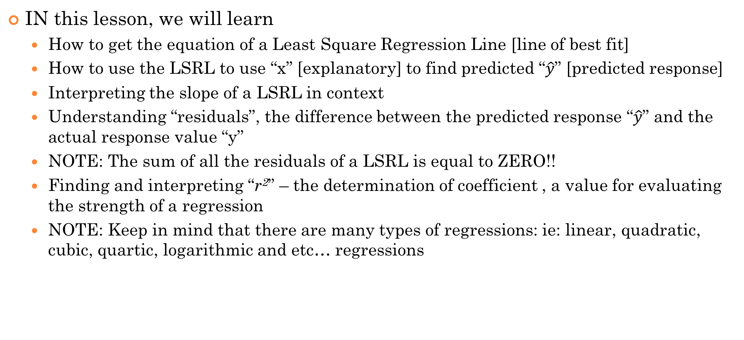
SUMMARY of this Section:
IN this lesson, we will learn
How to get the equation of a Least Square Regression Line [line of best fit]
How to use the LSRL to use “x” [explanatory] to find predicted “$\hat{y}$” [predicted response]
Interpreting the slope of a LSRL in context
Understanding “residuals”, the difference between the predicted response “$\hat{y}$” and the actual response value “y”
NOTE: The sum of all the residuals of a LSRL is equal to ZERO!!
Finding and interpreting “r²” – the determination of coefficient , a value for evaluating the strength of a regression
NOTE: Keep in mind that there are many types of regressions: ie: linear, quadratic, cubic, quartic, logarithmic and etc… regressions

Slide 3
NO/BAD: YOU ARE NOT USING “x” to predict “y’
YES/GOOD: INSTEAD, you are using “x” to find a “predicted y”

Slide 4

Lease Square Regression Line
Aka “Line of Best Fit”
This line uses “x” to get a predicted “ ”
“x” (L1) is the Explanatory Variable, “y” (L2)response variable
is a predicted response value based on the LSRL, not actual value (Keep this in mind!!!)
A best Fit Line (equation) is used to find the predicted y value a given value of x. (Not provide actual values)
One main challenge is knowing which variable is the explanatory and which is the predicted value
Note: The LSRL will have errors(residuals), the difference between actual y-value and predicted value
For every increase in 1 unit of “x”, there is an increase of ?? Units with predicted “$\hat{y}$”

Slide 5
Ex: The following LSRL shows the association between test mark (M) with the number of hours spent studying (H) each day in an AP Course. M = 15H+30
Which of the following would be a correct interpretation
a) Students studying 3 hours a day would get a score around 75%
b) Students that study only an hour a day will likely fail
c) Based on the LSRL, students that study 4 hours a day will on average get about 90%
d) Based on the LSRL, students that study 3 hours a day will get a predicted mark of 75%
e) The LSRL can be used to predict actual marks of students in this course

Slide 6
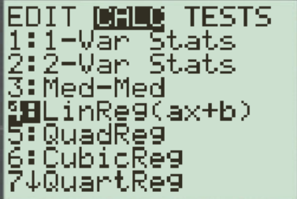
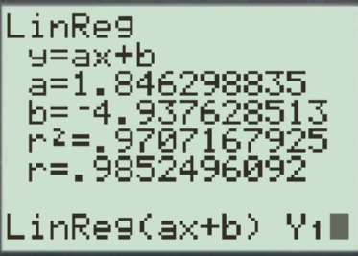
Finding Equation of LSRL:
Equation for the Least square regression line
To find the “correlation coefficient” (r) and the equation for the “least square regression line” just use the Ti-83!
Don’t bother calculating using the formula!!
b: Slope of the LSRL
‘r’ is the correlation
S_{x} and S_{y} are the standard deviations of each data set “x” and “y”
(slope)
Note: Make sure you turn “Diagnostic on” with Ti-83!!
Go to “Catalog” by pressing “2nd” and “0”
Mean “x” & “y”
Press “STAT” and “4:LinREg(ax+b)” after your data set is typed into L1 and L2
and are the means of each data set. The LSRL must cross through the coordinates of
(Y-intercept)
‘a’: Y-intercept of the LSRL
Two conditions must exist before fitting an LSRL to data:
1. The data must show a linear trend (we use r for this)
2. There must be an explanatory/response relationship
Are Explanatory and Response Variables interchangeable with a LSRL?

Slide 7
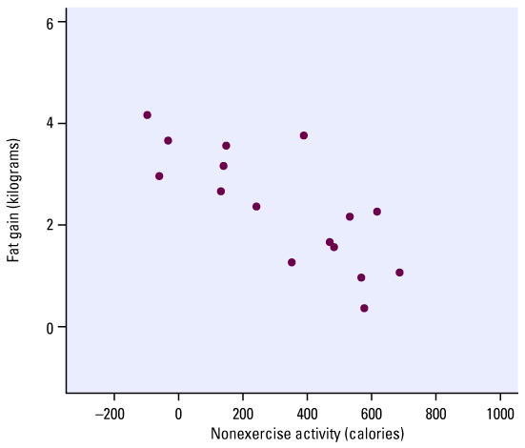
What is Residual?
Remember, LSRL is never perfect, it only provides predictions
Think of the residual as error
is the actual value
is the predicted value
Residual is difference between
+’ve → Underestimated
–’ve → Overestimated

Slide 8
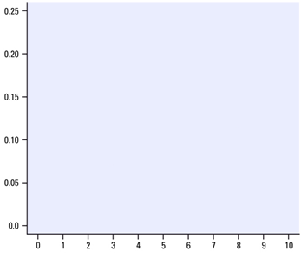
Why is it called Least Square Regression Line (LSRL)?
The sum of all the residuals is equal to ZERO
Minimizes the “sum of the areas” of all the squares created by the residuals
Minimize:
Your LSRL aims to minimize the squares of ONLY THE VERTICAL residuals!! NOT horizontal residuals!!!
NOTE: the LSRL is NOT interchangeable! CAN NOT use “Y” to predict “x”. You need to create a NEW LSRL by reversing L1 (x) and L2 (y). The new LSRL aims to reduce the residual with “x”

Slide 9
Ex: Lung cancer and Smoking
The following table shows data collected from a survey on the number of years people smoked and the percentage of lung damage they sustained.
Plot the data and find the correlation coefficient “r”
Define the explanatory and response variables
Find the equation of the LSRL for getting the percentage of lung damage from years of smoking?
Interpret the slope
What is the percentage of lung damage from someone that has been smoking 20 years, based on the LSRL? Write a concluding statement.

Slide 10
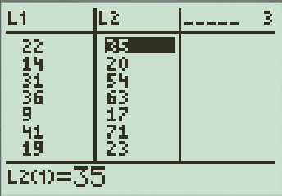
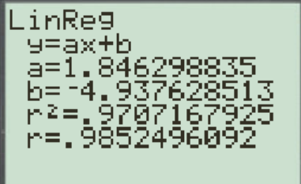
The first step is to indicate what your variables are!!! It is important to be exact and precise when describing your variables!
“x”: Number of years smoking
Make sure you explicitly say “predicted” !!
: Predicted Percentage of Lung Damage
A correlation of 0.985, indicates a strong association between the two variables
Concluding statement: Someone smoking for 20years will have a predicted lung damage of 32%.
The slope of 1.846 means that for each additional year of smoking, the percentage of predicted lung damage increases by 1.846%
Note: This is the predicted lung damage percentage, NOT the actual lung damage percentage!!!

Slide 11
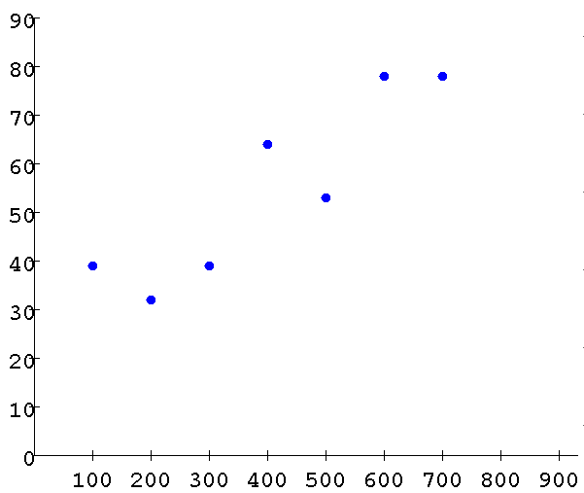
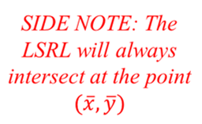
Coefficient of Determination
r² is used to determine how well the LSRL does at predicting values of the response variable ‘y’
In general, the LSRL is compared against an “average line” of the points (which one is a better predictor?)
If r² is close to 1, then the LSRL is a better model for using ‘x” to predict “y”
REMEMBER THIS: r² will indicate the percentage of the variation in the response variable “Y” that can be explained by the LSRL with “X”

Slide 12
Square residuals from LSRL
Square residuals AVG line
The difference in squared residuals from LSRL and AVG line
Total squared residuals from the AVG line
The value of r² is a comparison of the residuals created by the LSRL vs the “Average line”

Slide 13
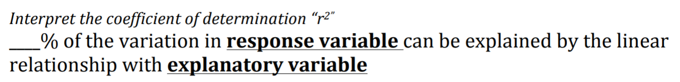
Remember this sentence, use it to write your interpretation of r²:
Suppose we are using a child’s age to predict their weight and “r” is equal to 0.90655, what is your interpretation of r² ?
This means that: 82.183% of the variation in your child’s weight can be explained by the linear relationship with your child’s age.
Using your walking speed to predict pulse rates. “r” is equal to 0.960786. what is your interpretation of r² ?
92.3% of the variation in pulse rate can be explained by the linear relationship with walking speed

Slide 14
Practice: The weights of children in the Egyptian village of Nahya were recorded. Here are the mean weights of the 170 children in that village:
A) Make a scatterplot of mean weight against time. Don’t forget to scale and label your axes appropriately.
B) Now use your calculator to find the LSRL. Write the equation with WEIGHT as a function of AGE. GRAPH the LSRL onto the scatterplot on the Ti-83. Interpret the slope!
C) Use your equation to predict the weight of a child who is 7.5 years old.
D) In contrast, use your equation to predict the age of a child who weighs 6 kg. Can we use weight to predict age?
E) The LSRL always passes through the point ( ). Show that this is true for the LSRL above
F) Use the data above to calculate the residuals for ages 3, 5, and 7
G) Interpret the value of r²

Slide 15
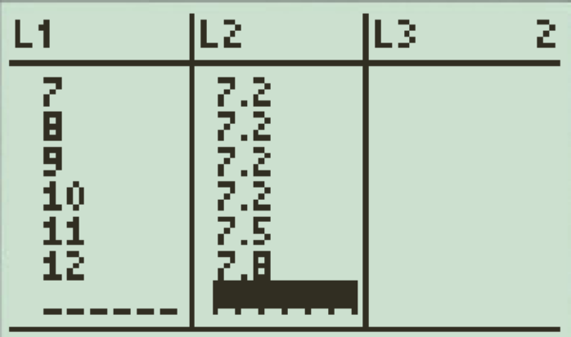
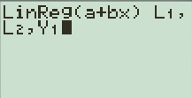
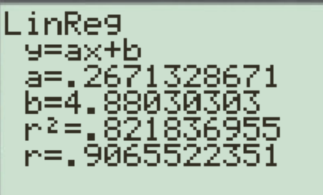

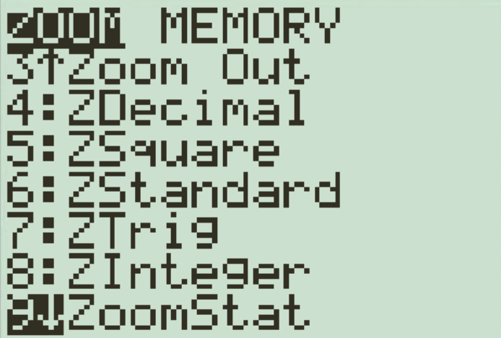
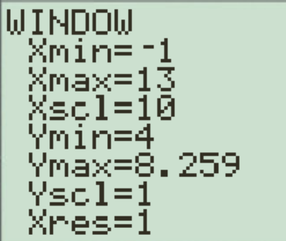
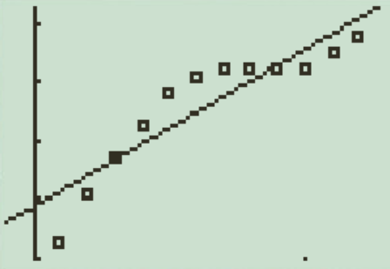
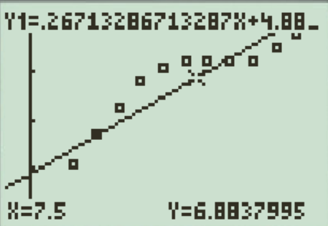
The first step again is to the state both explanatory and predicted response variables!
a) Explanatory Variable (x) → Age of children (years)
Response Variable (ŷ) → Predicted Weight (pounds)
Enter “Age” in L1 and “predicted weight” in L2
One of the issues with using a LSRL is that it the data may not fit a linear model
Notice that there is a “curved” pattern on the scatterplot. This means that a linear model is not a good fit for this data
The predicted weight at 7.5 yrs old is 6.88379 lbs

Slide 16
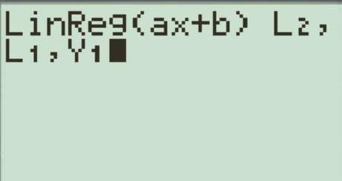
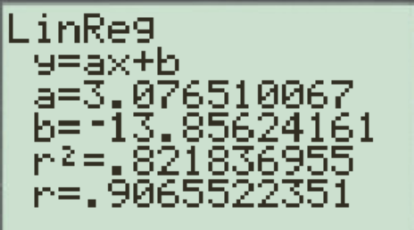
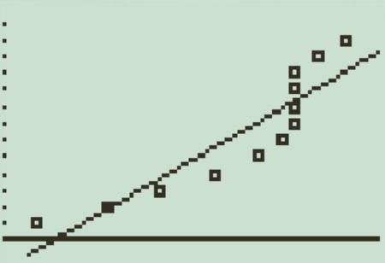
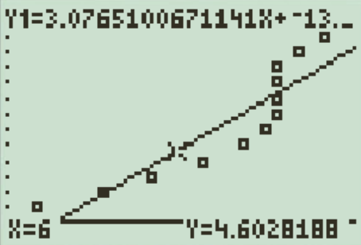

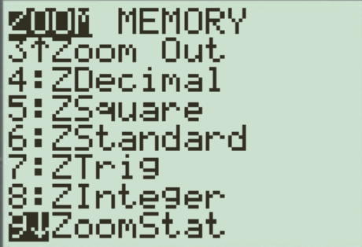
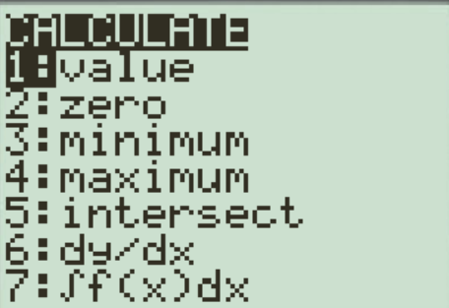
D) Use the regression to find the age of a child weighing 6kg
It is important to understand that the regression line we have is for predicting the weight for a child for any given age. The line minimizes the sum of the squared vertical distances of points from the line. The response variable is the “weight” and the explanatory variable is the “age”.
When we predict the age, the roles of the variables are reversed. We need another regression line that minimizes the sum of the squared “horizontal” distances of points from the line.
Note: L1 and L2 are switched!
LSRL Eq:
Age
Switch the two variables and graph it again using a different plot
Weight (kg)
When we use weight to predict age, a child weighing 6kg would have a predicted age of 4.6 years old

Slide 17

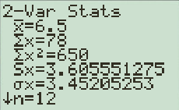
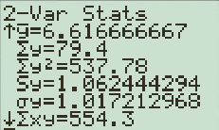
E) Find the coordinates of
Find the mean of each variables using a 2-variable statistics calculation
STAT
Calc
2: 2-Var Stats
ENTER
ENTER
Mean “X”
Mean “X”
Plug the values into your regression formula. If both sides are equal, then the equation will intersect the point (6.5, 6.16667)
Since the coordinates of satisfies the regression line, then it must intersect that point

Slide 18
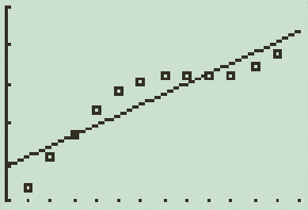
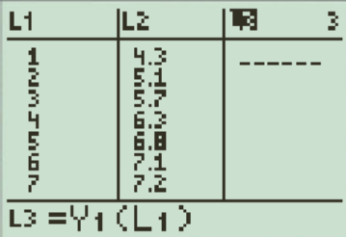
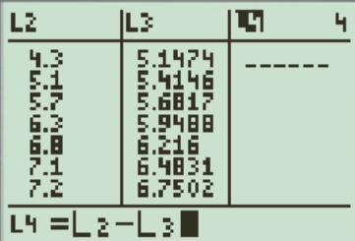
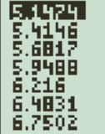
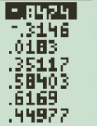
F) Finding Residuals
Use the regression line to find the predicted weights for each of the ages: 3, 5, and 7
To find the residual, subtract the predicted weights from the actual weights
Finding the residual is important b/c in the next section, a residual plot is used to determine if the LSRL is a good fit or not

Slide 19
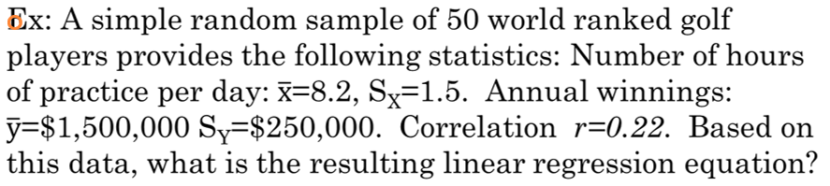
a) Predicted Winnings = 1,500,000+250,000(hours)
b) Predicted Winnings = 1,199,333+36,666(hours)
c) Predicted Winnings = 1,750,000+8.2(hours)
d) Predicted Winnings = -1,000,000+36,000(hours)
e) Predicted Winnings = -1,199,000+40,000(hours)

Slide 20
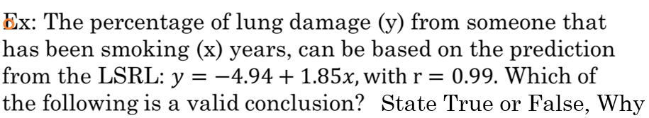
a) A person smoking for 20 years will have 32% of their lungs damaged
False, the LSRL is for finding predicted values only
b) The predicted lung damage is 32% for someone that has been smoking for 20 years
True
c) With r = 0.99, this is strong evidence that smoking causes lung damage
False, a strong “r” only indicated a strong association. Does not imply causation. Problem with statement is the word “Cause”
d) The percentage damage for someone smoking 20 years can be greater or less than 32%.
True, the LSRL is for finding predictions only. Actual values can be bigger or smaller

Slide 21
A researcher uses a regression equation to predict home heating bills (dollar cost), based on home size (square feet). The correlation between predicted bills and home size is 0.70. What is the correct interpretation of this finding?
(A) 70% of the variability in home heating bills can be explained by home size.
(B) 49% of the variability in home heating bills can be explained by home size.
(C) For each added square foot of home size, heating bills increased by 70 cents.
(D) For each added square foot of home size, heating bills increased by 49 cents.
(E) None of the above.
This means that 49% of the variation in your heating bill
is due to the size of your house. 51% of the variation can be
due to other factors, ie: age of your house/fixtures, energy
awareness, climate conditions...etc

Slide 22
Coefficient of Determination!
Note: The LSRL is never perfect! The prediction is only an estimate. All regressions are imperfect!
One way to measure the effectiveness of the LSRL is to use r² “Coefficient of determination”
If r² is close to 1 tells, then the LSRL is a good model for the predicting
In general, if LSRL is bad, then might as well use
to estimate response value

Slide 23
Coefficient of Determination
r² is used to determine how well the LSRL does at predicting values of the response variable ‘y’
“Sum of squared residuals(errors)” - Sum of all the residuals squared when using LSRL
Note: The LSRL aims to reduce SSE!!
If SSE is smaller, then LSRL is a good model or the data
“Total sum of squared errors”- sum of all the errors squared when we use the mean to estimate values of “y”
Note: If SST is large, then the mean is a bad estimation
Also, if SSE is small, then r² will be close to 1
Again, if you want to find r², just use Ti83!!
Indicates how much error is reduced by using the LSRL
rather than the mean
Purpose: Compare the improvements from using LSRL
over the squared errors from using the mean
That’s why we divide by SST

Slide 24
Summary of Phrases to Remember:
Correlation: (r) - positive/negative, weak/strong linear association between explanatory variable and response variable
r²- “x” percent of the variation in the response variable can be explained by the approximate linear relationship with the explanatory variable
Slope – for every 1 unit increase in the explanatory variable, our model predicts an average increase of y-units in the response variable
Y-intercept – at an explanatory variable value of 0 units, our model predicts a response variable value of y-units (Does this make any sense)

Slide 25
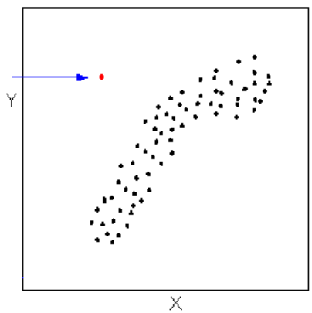
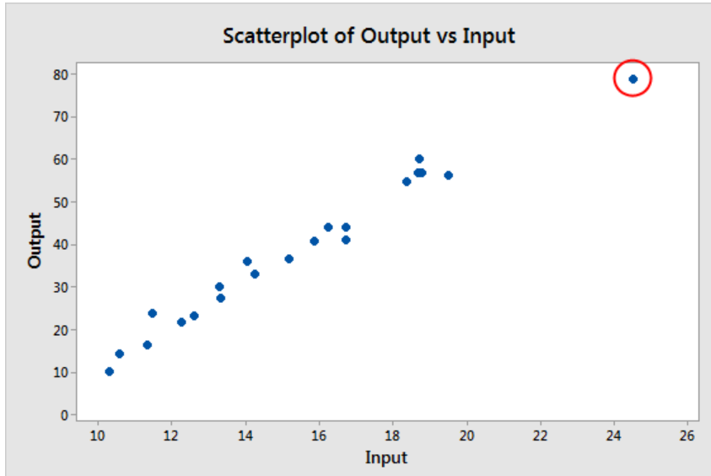
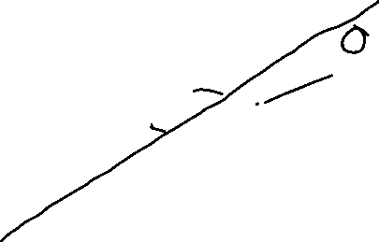


Outliers vs Extreme Values:
An outlier is defined as a data point that emanates from a different model than do the rest of the data. The data here appear to come from a linear model with a given slope and variation except for the outlier which appears to have been generated from some other model.
Extreme values (which are also ‘outliers’) are data points that are distanced from the rest of the data points
Outlier (Does not fit the rest of the data)
Extreme Value (Also an outlier)

Slide 26
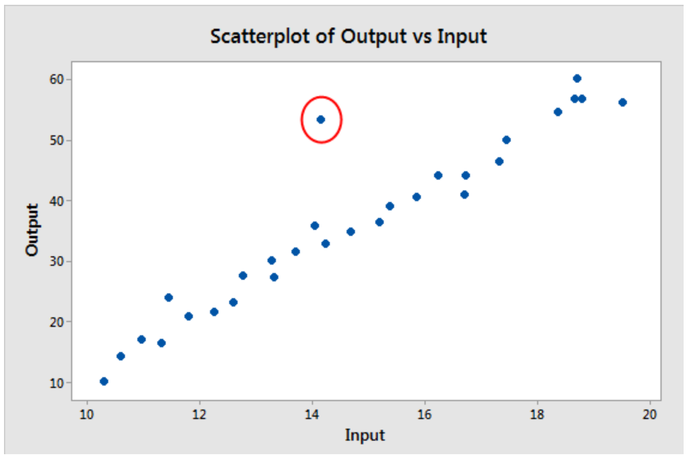
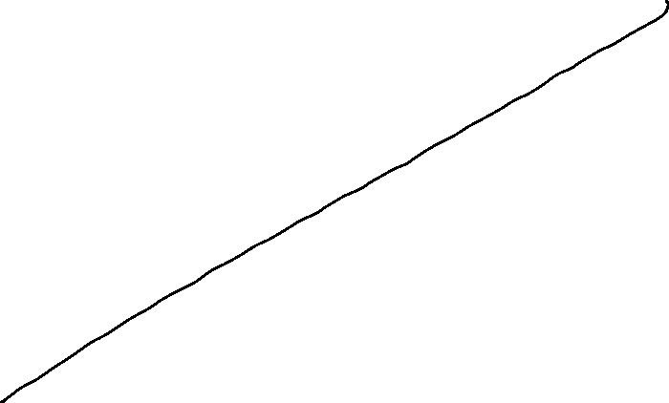
The data point circled is an outlier BUT not an extreme point
This point is an outlier b/c it doesn’t fit the rest of the data. However, it is NOT an extreme value

